Slide 1

Enterococcus Accumulated in Rainwater Puddles
Alessia Muccitelli
CME 502 Spring 2024
Other Group Members: Emily Marcinauskis & Ethan Porter

Slide 2
Introduction
CSO's (Combined Sewage Overflows) are a contributing factor for marine pollution during periods of light and heavy rainfall. This can contribute to higher amounts of pathogens contributed by nonpoint source loading.
Enterococcus is a bacteria resembling Streptococcus and is commonly found in the intestines of all living animals. This bacteria is considered a FIB (Fecal Indicator Bacteria), where it can be tested for and found in the lab.
Enterococcus values are believed to spike after periods of rainfall through nonpoint sources. Some potential sources of enterococcus include birds, rodents, small mammals, and dogs.
Enterococcus can be found in puddles after rainfall, and these puddles could be produced from runoff. Some of the puddles sampled were regular puddles collected from rainfall, while some puddles were at the bottom of a hill, etc, collecting into a puddle at the bottom.

Slide 3
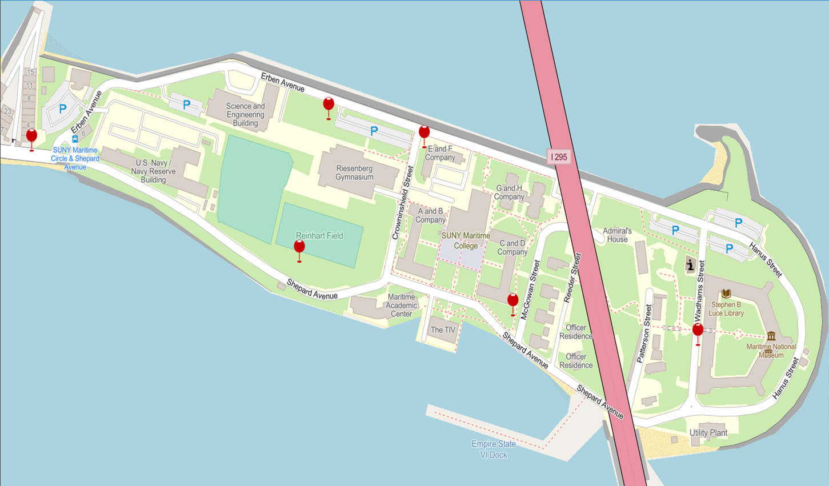

Materials and Methods
Collected Samples from puddles around campus when it rained.
Used 175-200 ml Bottles, collected with Pipettes
The Enterococcus Rainwater was sampled using the IDEXX method
SUNY Maritime College
Location of Puddles
E&F Company (Baylis Hall) Controlled Rainwater Sample

Slide 4
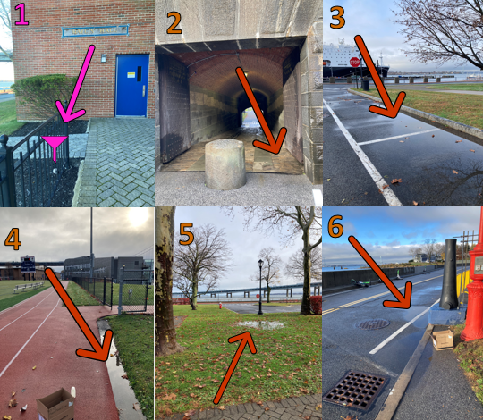
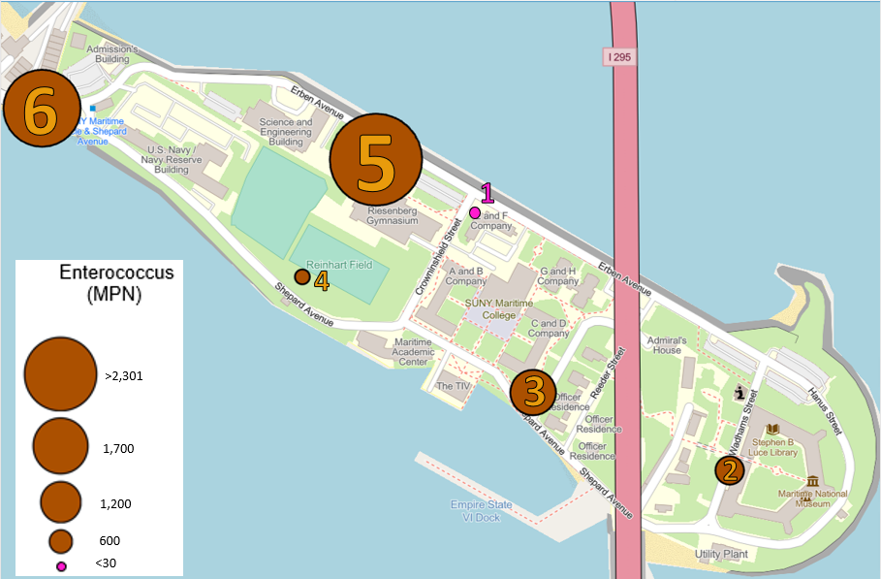
Results
Enterococcus is measured in MPN (Most Probable Number)
The EPA safety standard to go swimming in natural waters is 35 MPN

Slide 5
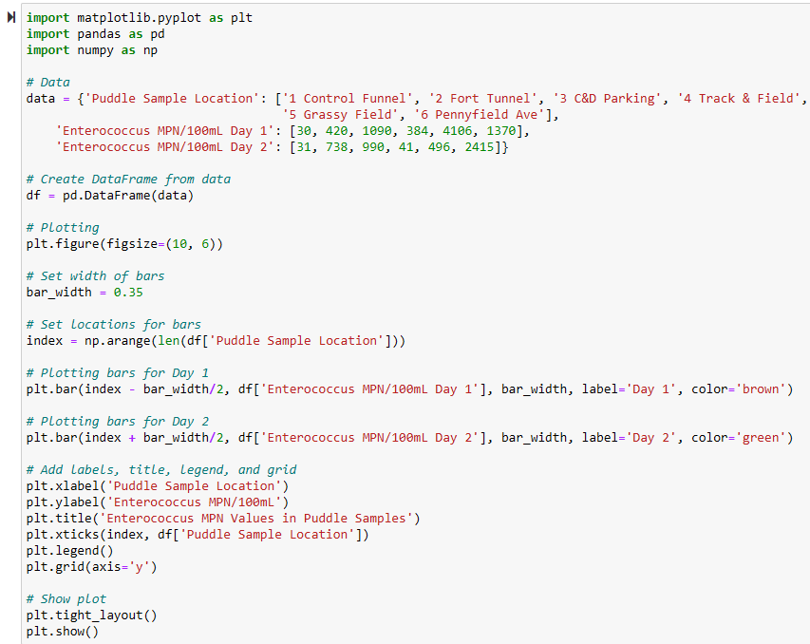
Plotting Results with Python
Notes:
df= pd.Dataframe(data): The dataframe organizes the data in a structured format
plt.figure(figsize=(10, 6)): Creates a new figure with a specific size of 10 inches width and 6 inches height.
bar_width = 0.35: Sets the width of the bars in the bar plot.
index = np.arange(len(df['Location'])): Creates an array of equally spaced values from 0 to the length of the 'Location' column in the DataFrame df.
plt.bar(index - bar_width/2, df['Day 1'], bar_width, label='Day 1', color='brown'): Plots the bars for Day 1 at positions shifted to the left of the center of each location on the x-axis. The heights of the bars are taken from the 'Day 1' column of the DataFrame df. The bars have a width of bar_width, a label of 'Day 1', and a brown color.
plt.bar(index + bar_width/2, df['Day 2'], bar_width, label='Day 2', color='green'): Plots the bars for Day 2 at positions shifted to the right of the center of each location on the x-axis. The heights of the bars are taken from the 'Day 2' column of the DataFrame df. The bars have a width of bar_width, a label of 'Day 2', and a green color.
plt.xlabel('Puddle Sample Location'): Sets the label for the x-axis.
plt.ylabel('Enterococcus MPN/100mL'): Sets the label for the y-axis.
plt.title('Enterococcus MPN Values in Water Samples'): Sets the title of the plot.
plt.xticks(index, df['Puddle Sample Location']): Sets the locations of the x-ticks and their labels. The tick locations are specified by index, and the tick labels are taken from the 'Puddle Sample Location' of the DataFrame df.
plt.legend(): Adds a legend to the plot.
plt.grid(axis='y'): Adds grid lines to the plot along the y-axis.
plt.tight_layout(): Adjusts the layout of the plot to make sure everything fits nicely.
plt.show(): Displays the plot.

Slide 6
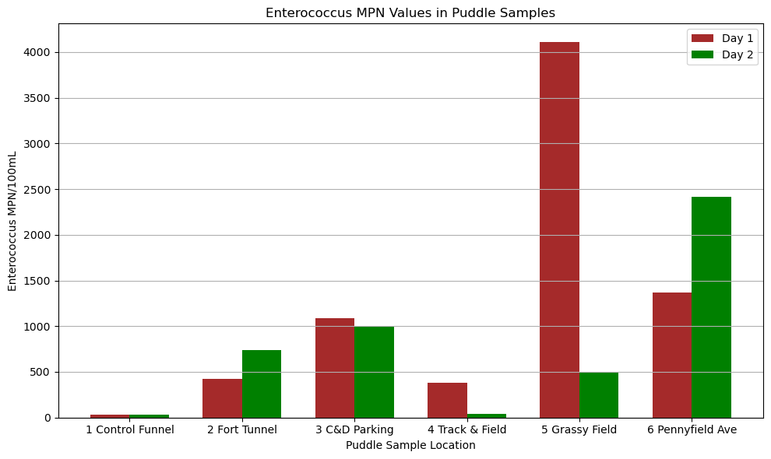

Slide 7
Results
Site 1 was located outside the side door of Baylis Hall had MPN values of 30 and 31.
Site 2 was located at the top of the fort tunnel where the puddle was made from runoff from the top of the tunnel, had MPN values of 420 and 728 MPN.
Site 3 was located on the street outside C & D had MPN values of 990 and 1090.
Site 4 was on the track near the ramp from the MAC parking lot had MPN values of 41 and 384.
Site 5 is the grassy field outside of Athletics and the S&E had values of 496 and 4106 which was the largest recorded MPN value.
Site 6 is located on Pennyfield Ave on the corner turning out of the gate from the campus had recorded values of 1370 and 2415 MPN which was the second largest recorded value. When collecting from this puddle, it smelled like feces. This puddle was also near a sewer drain that can most definitely overflow during heavy rain.

Slide 8
Conclusion
While the results agreed with the original hypothesis, they far exceeded initial expectations. Animal density being the main contributor to recorded MPN values.
Site 5 (Grassy Field) had the largest MPN values which is due to most of the bird and small animal populations located in the surrounding area.
Many dog owners also walk their pets in these environments which contributes to the overall MPN values when they defecate. This factor can explain Site 6 (Pennyfield Ave).
Sites 2-4 have between 100 to 1000 MPN which shows some animal activity but not as much as Sites 5-6 due to no habitable areas, but animals have been seen passing through which would be the source of noticeable Enterococcus for these sites.

Slide 9
Conclusion Continued & Future Studies
Increased enterococcus values, had a direct correlation to animal activity which is why the results for Site 1 (direct rainwater collected from a funnel open to the rain) was so surprising. It indicates that as rain condenses and falls from the clouds, it collects enterococcus present in the atmosphere. Which means that the baseline enterococcus MPN values before touching the ground, were not zero as we assumed.
Potential research could be done on puddle runoff into the East River to see if it would be considered a notable source of enterococcus or is it lumped in with land runoff as a point source. Research into atmospheric enterococcus and how it even gets into the atmosphere would be an interesting topic of study.
There can also be further studies to see if enterococcus evaporates with the water vapor back into the clouds and/or how it interacts with water molecules

Slide 10

Questions?

